Slide 1
Identifying Product Bundles from Sales Data using Market Basket
GROUP MEMEBERS:
PROJECT CO-ORDINATOR:
Ashish Neupane(89856)
Bibek Dhakal(89858)
Bijay Aryal(89860)
Nabin Kandel(89870)
Er. Narayan Adhikari Chettri
SUPERVISOR:
Er. Ramesh Tamang

Slide 2
1. BACKGROUND
Price optimization is the concept of offering goods at different prices which varies according to customer’s demand
Bundling is a promotion strategy in which sellers provide multiple products or events as a single package with an attractive price
Consumer’s desire for buying related products at the same time, seller have to provide combinations of products in order to facilitate the purchasing process

Slide 3
contd.…
Advantages of bundling the product
Increase sales for the seller by keeping similar products nearby
Allow to clear the deadstock by offering combo offer

Slide 4
2. PROBLEM STATEMENT
Allows buyers to see the sales process clearly and pick up exactly the products they want
Provide several products together as a bundle, and buyers can purchase that bundle

Slide 5
3. OBJECTIVES
GENERAL OBJECTIVES
To implement sales using product bundling strategy
SPECIFIC OBJECTIVES
Recommend new products to customers
To discover items that are most likely to be purchased together(bundle) by mining historical data of transactions
To predict which product will be in user’s next order

Slide 6
4. SYSTEM DESIGN

Slide 7
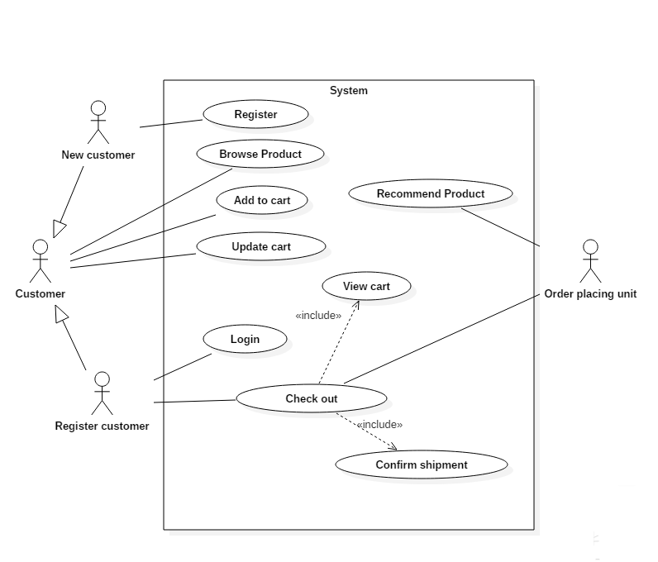
4.1 USE CASE DIAGRAM

Slide 8
5. METHODOLOGY

Slide 9
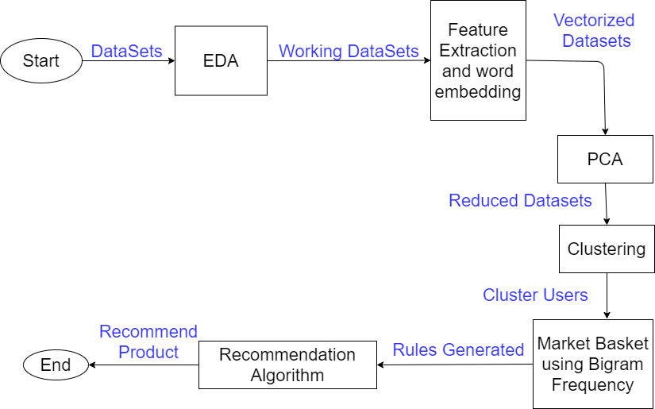
5.1 WORKFLOW DIAGRAM

Slide 10
5.2 DATASET DESCRIPTION
The dataset contains sample of over 3 million grocery orders from more than 200,000 instacart users
There are basically 5 datasets provided:
1.Orders.csv: this file contains all information about given order like: user who has made the order, when was the product purchased and days since prior order.
2.Order_products.csv: this file has detailed information about the product that has been brought in the given order along with reordered status
3.Products.csv: this file contains the name of products with their corresponding product_id
4. Aisles.csv: this file contains the different aisles name (passage in department store) with aisle_id
5.Departments.csv: this file contains the different department name (which contains aisle and products) along with the department_id

Slide 11
5.3 EXPLORATION
Exploring the datasets(three major points):
1.3,421,082 orders made by 206,209 instacart users
2.A single customer has made from 4 to 100 orders.
3.Orders are high during Saturday and Sunday - 10am to 11 am has highest order done in a day followed by 12pm to 4pm - from 5pm no. of order seems to be decreasing

Slide 12
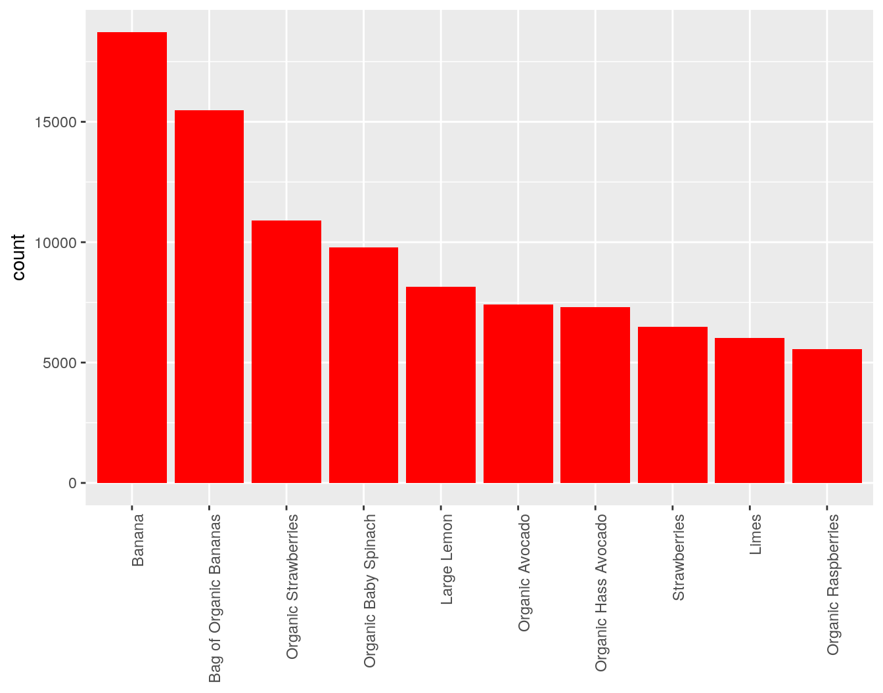
Looking at the best sold product or top product that customers has made clearly mentioned that banana is best sold product. Around 18,726 bananas have been ordered by user. Looking at the top 10 best sold products:

Slide 13
5.4 FEATURE EXTRACTION
Once the final working dataset is ready some of the features are directly extracted while other are done using word2vec analysis.
Some of the features that are directly extracted includes:
Mean of order placed day of week
Mean of order placed hour of day
Mean of days since last order
Total number of orders made
Total number of products brought

Slide 14
5.4.1 WORD2VEC ANALYSIS: Save customer based on their buying habits
Word embedding are text converted into numbers and there may be different numerical representations of same text
In word2vec analysis, we combine all the product name into one row per user and the customer buying habit includes:
Which day of week?
Which hour?
Days since last order
Number of total orders

Slide 15
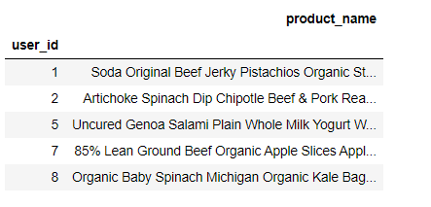
Contd…
Input data for word2vec is each row per user considering each row is a bag of words as:
The word2vec model transforms each row into vector using average of all words available in that word.
Figure : Input data for word2vec analysis

Slide 16
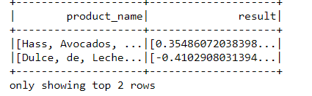
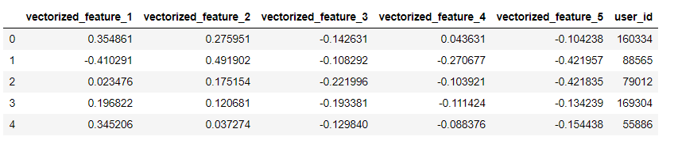
Contd…
After learning a mapping from each row to vectors and saving the result as:

Slide 17
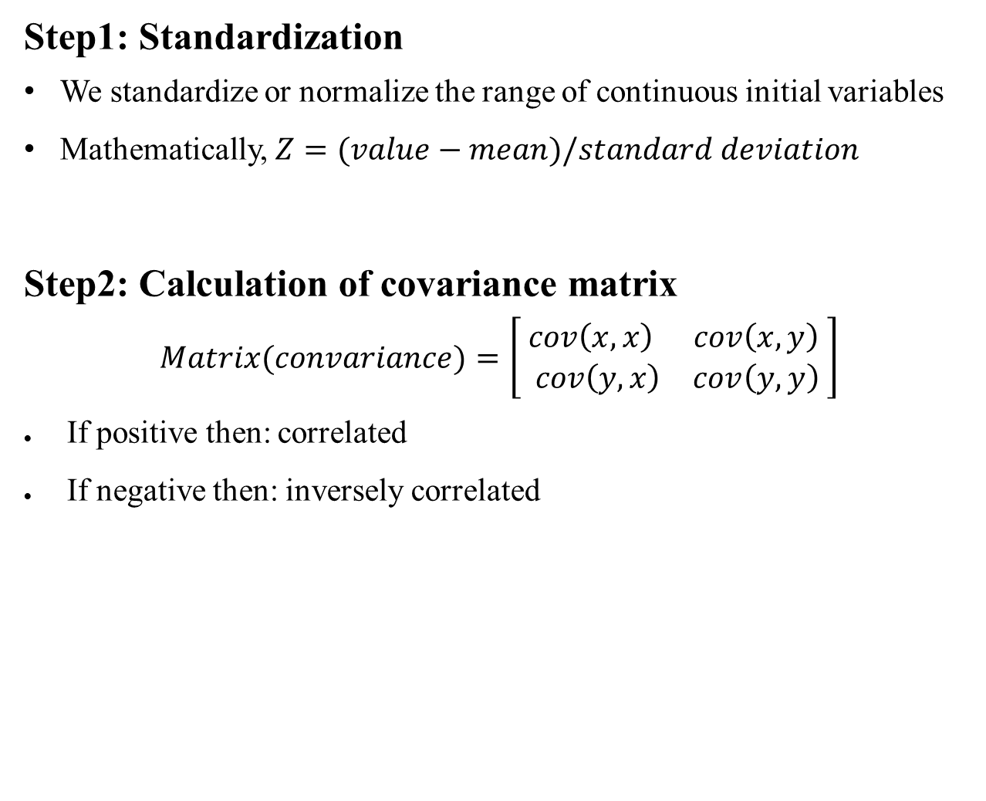
5.4.2 PCA(Principal Component Analysis)
Step1: Standardization
We standardize or normalize the range of continuous initial variables
Mathematically, $Z=(value−mean)/standard deviation$
Step2: Calculation of covariance matrix
$$Matrix(convariance)=\left[\begin{matrix}cov\left(x,x\right) & cov\left(x,y\right) \\ cov\left(y,x\right) & cov\left(y,y\right)\end{matrix} \right]$$
If positive then: correlated
If negative then: inversely correlated

Slide 18
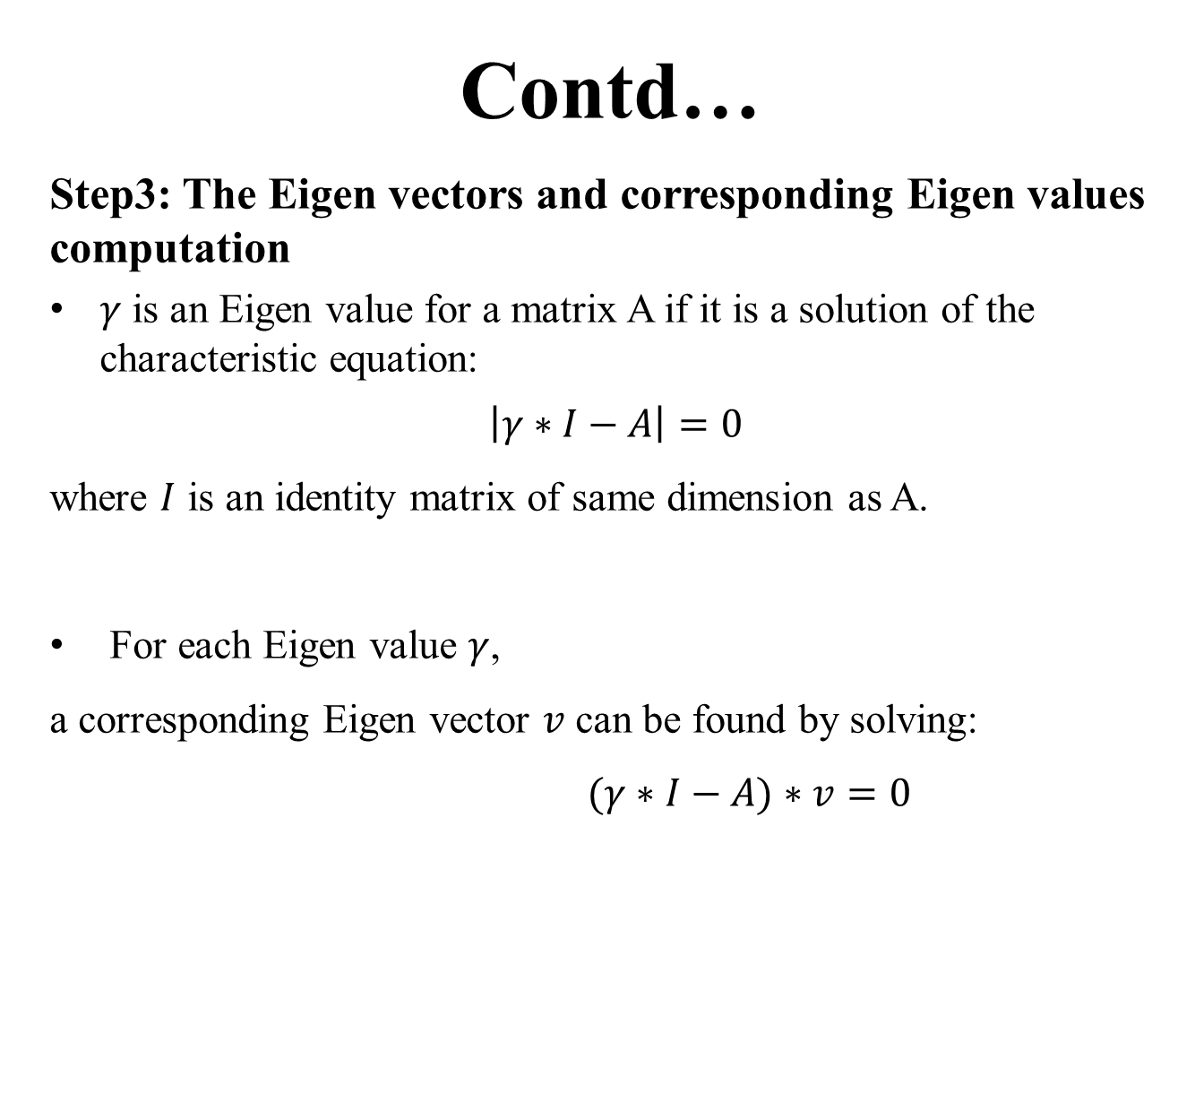
Contd…
Step3: The Eigen vectors and corresponding Eigen values computation
$γ$ is an Eigen value for a matrix A if it is a solution of the characteristic equation:
$$\left|γ∗I−A\right|=0$$
where $I$ is an identity matrix of same dimension as A.
For each Eigen value $γ$,
a corresponding Eigen vector $v$ can be found by solving:
$(γ∗I−A)∗v=0$

Slide 19
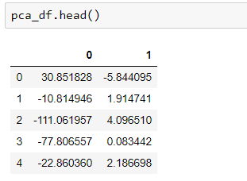
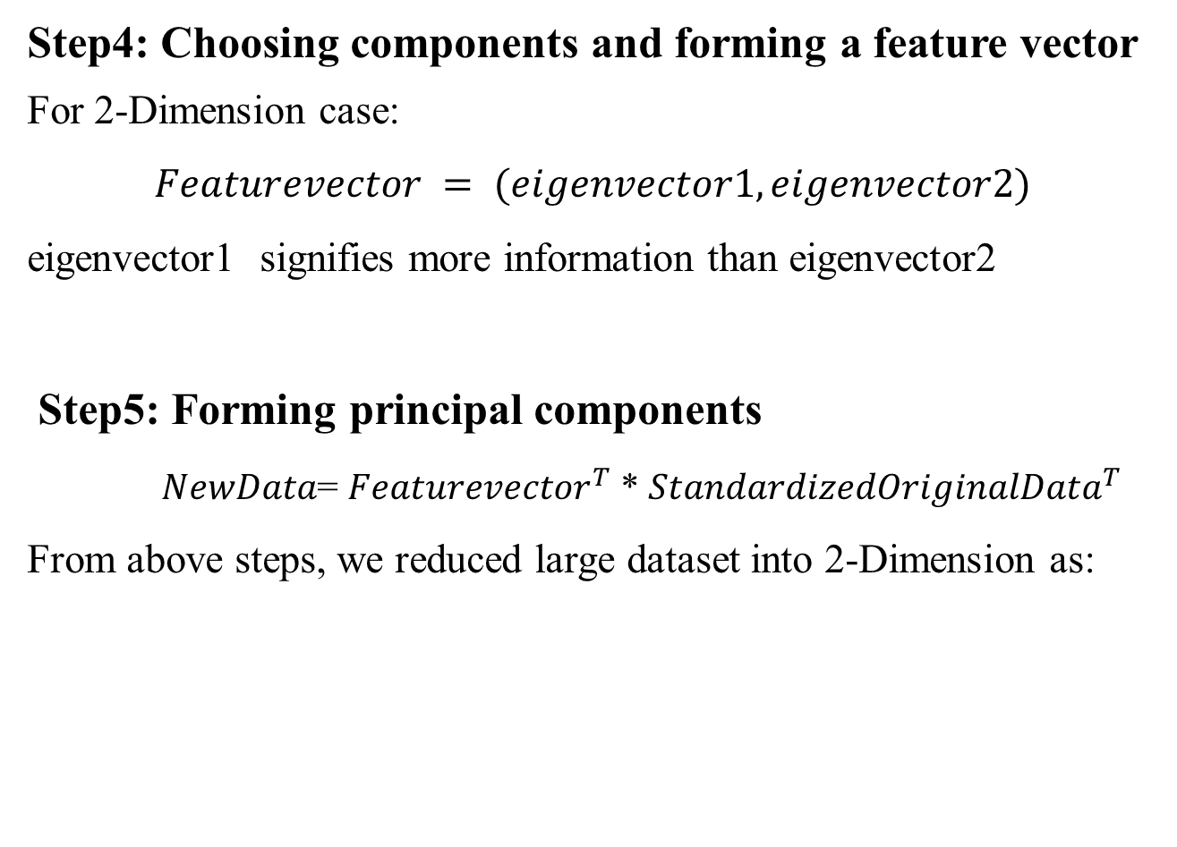
Step4: Choosing components and forming a feature vector
For 2-Dimension case:
$$Featurevector = (eigenvector1, eigenvector2)$$
eigenvector1 signifies more information than eigenvector2
Step5: Forming principal components
$NewData$= ${Featurevector}^{T}$ * ${StandardizedOriginalData}^{T}$
From above steps, we reduced large dataset into 2-Dimension as:

Slide 20
6. CLUSTERING: Cluster user based on their buying habits and preference
After dimensionality reduction, next step is to cluster user which is done based on their buying habits and preference
The customer buying habit includes | The preference includes:
Which day of week? | Number of total products
Which hour? | Preferred vector from word2vec analysis
Days since last order
Number of total orders

Slide 21
6.1 k-mean clustering
Algorithm:
BEGIN
Find the optimal number of cluster K using the elbow method and get the cluster centers m = {m1, m2,….. k}
Repeat
For each object 𝑝 ∈ 𝐷
set p to the cluster 𝐺𝑖 ← arg 𝑚𝑖𝑛 𝑖 |𝑝 − 𝑚𝑖 | ^2
For each cluster 𝐺𝑖 ∈ 𝐺
𝑚𝑖 ← the mean value of all objects belongs to 𝐺𝑖
until no changes;
END

Slide 22
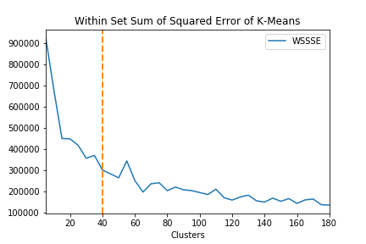
6.2 Before applying k-means clustering
The optimal number of clusters is found by calculating the within set sum of squared error (WSSSE). It works as:
Step1: Error is calculated which is distance from each point of dataset to it is centroid
Step2: Square of that error is taken and finally summed up for entire dataset
Step3: Plot the curve of WSSSE according to number of clusters

Slide 23
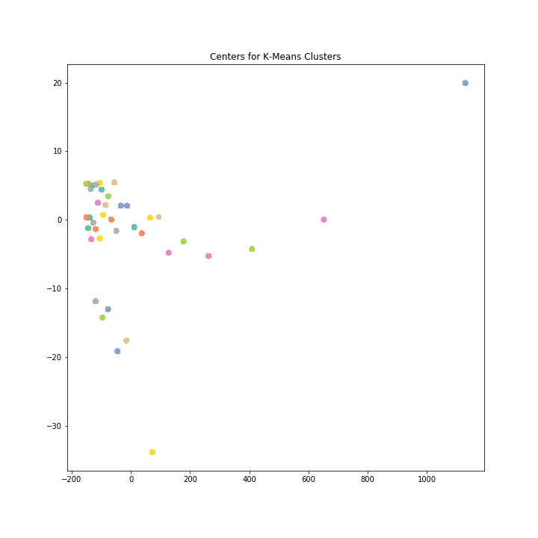
The optimal number of clusters for each user is calculated then the centers for each user is also calculated and visualizing the centers, it looks like this:

Slide 24
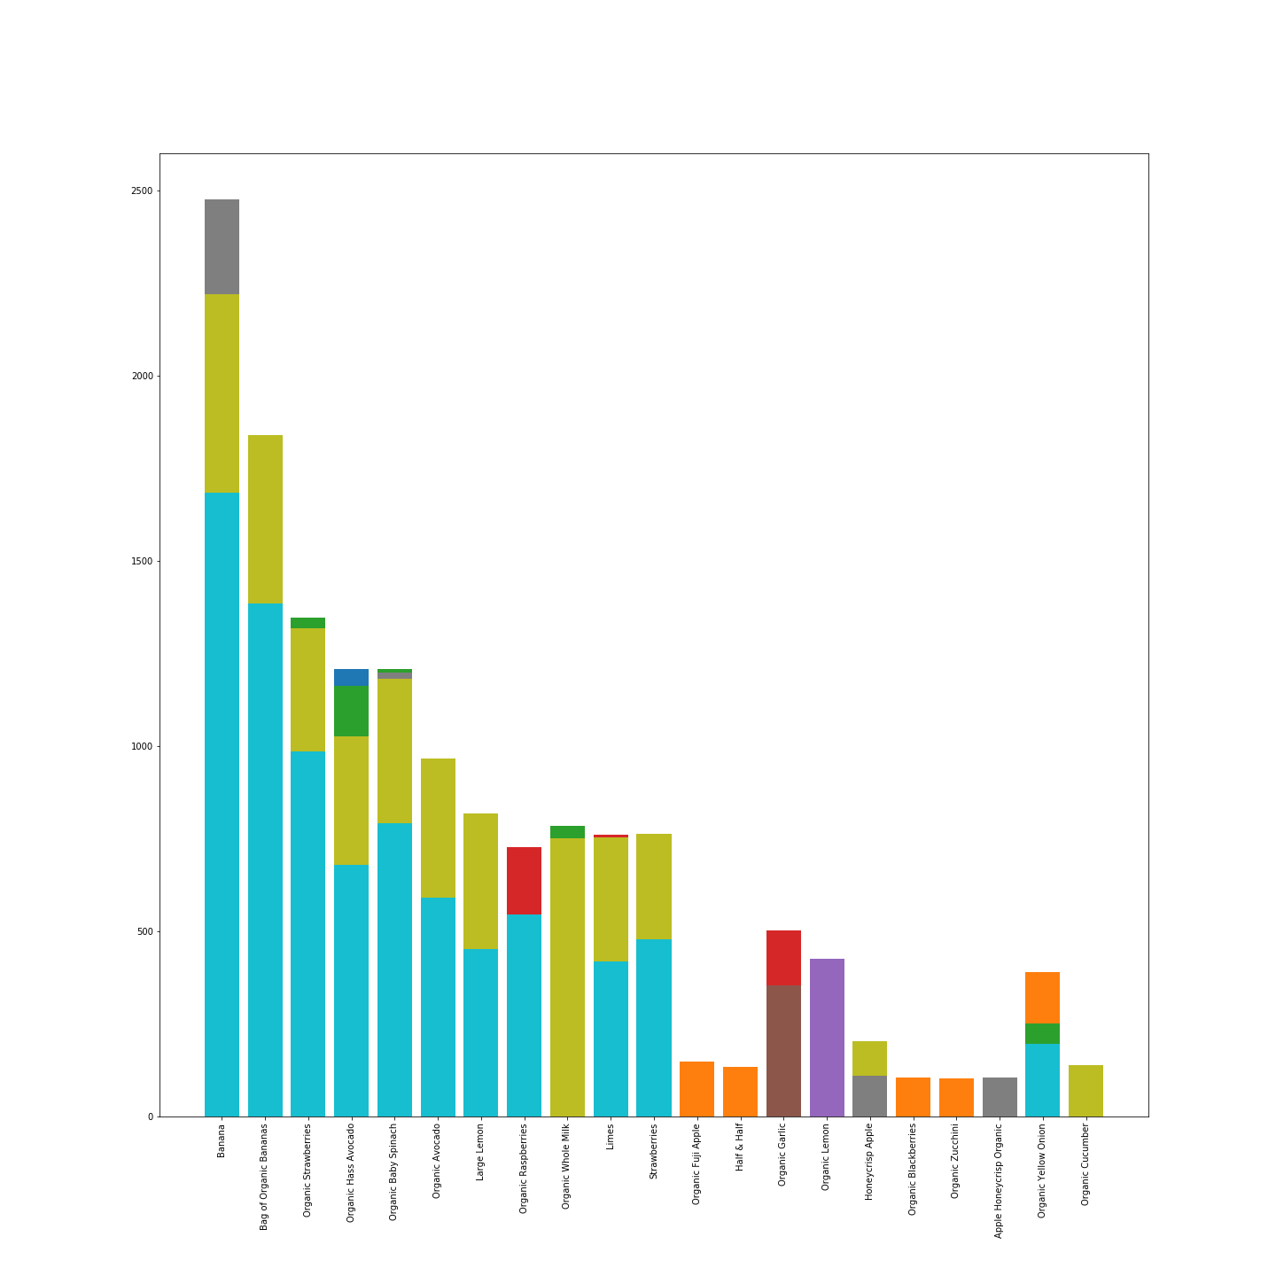
The result below shows the top common products in all cluster
Looking individually in all clusters, it was also found that banana, bag of organic banana, organic strawberries, organic hass avocado, Limes are top products in each cluster. In this way the most selling products is found

Slide 25
7. MARKET BASKET USING BIGRAM FREQUENCY
Objectives:
Find out which products are frequently bought together and to generate rules
Bigram is a sequence of two adjacent elements from a string of tokens
Includes two steps:

Slide 26
Step1: Extract bigram and calculate bigram frequency
Bigram is extracted based on order id of each cluster i.e in same order of each cluster which products are bought together
Format after extraction:
(
order ID:[products bought in that order id of each cluster]
)

Slide 27
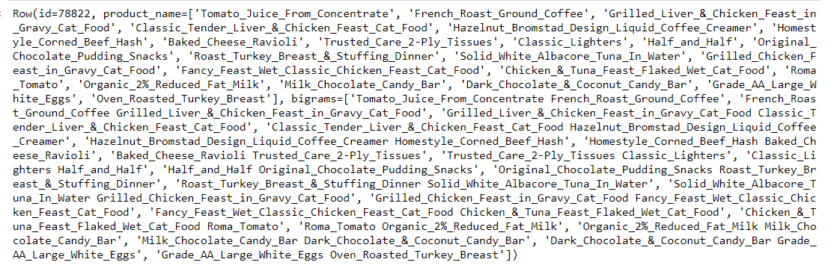
Contd…

Slide 28
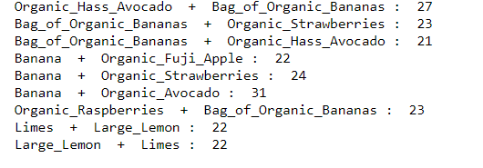
Contd…
Once the bigram is extracted, the bigram frequency is calculated which is obtained by adding the same products bought together
Looking at the popular bundles:

Slide 29
Step2: Save bigrams and bigram frequency to JSON file as rules
Bigram is stored in nested dictionary where
First layer key is first word in a bigram
Second layer key is second word in a bigram
Second layer value is the frequency
This dictionary is converted to JSON file as rule in the format:
{
Product Name: {
[{Recommended product list: frequency}]
}
}

Slide 30
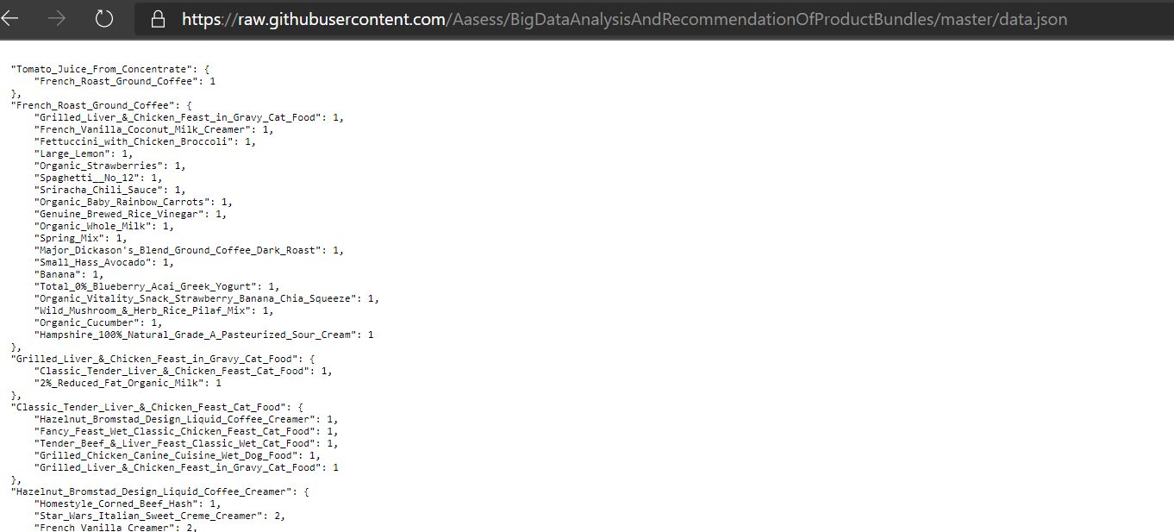
Contd…

Slide 31
RECOMMENDATION ALGORITHM
When customer add one product to cart, this algorithm will offer a list of recommended products to be bought together
Uses frequencies above to generate recommendations for each product
Step1: Sort bi-gram frequencies
For example if we have {‘apple’:{‘strawberry’:5,’avocado’:5,’banana’:7,’milk’:1}}. It will be sorted as:
‘apple’ + ’banana’: 7
‘apple’ + ’avocado’: 5
‘apple’ + ‘strawberry’: 5
‘apple’ + ‘milk’ : 1

Slide 32
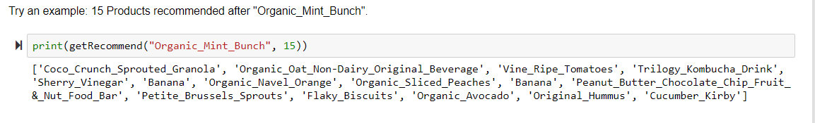
Contd…
Step2: Specify number of recommendation K
if k = 3: banana, avocado, strawberry
If k = 2: banana + randomly pick one in {avocado,strawberry}
If k > 4: all four + new recommendation of ‘banana’

Slide 33
RESULT AND CONCLUSION
Recommending customers with favorite products
Recommending the bundles of products to customers
Predicting which product will the customer buy
Helping E-commerce website on increasing sales

Slide 34
FUTURE ENHANCEMENT
None of payment method is integrated, Integration of different payment method will enhance the system

Slide 35
DEMO

